Slide 1
APP DEVELOPMENT

Slide 2
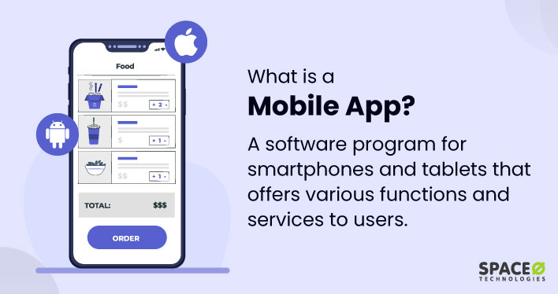

Slide 3




Slide 4
Which of the following tasks can be performed on apps?
A) shopping
B) tickets booking
C) Billing
D) all of these

Slide 5
MIT App inventor is a …………….. Service.
paid
Cloud based
Heavy
none
MIT app inventor provides?
Visual programming environment
CUI
Editor
None

Slide 6
MIT app inventor is a …………………….. Programming interface.
………………………. Can be defined as a type of software that can be installed and run on a computer, tablet, smartphone or another electronic devices.

Slide 7
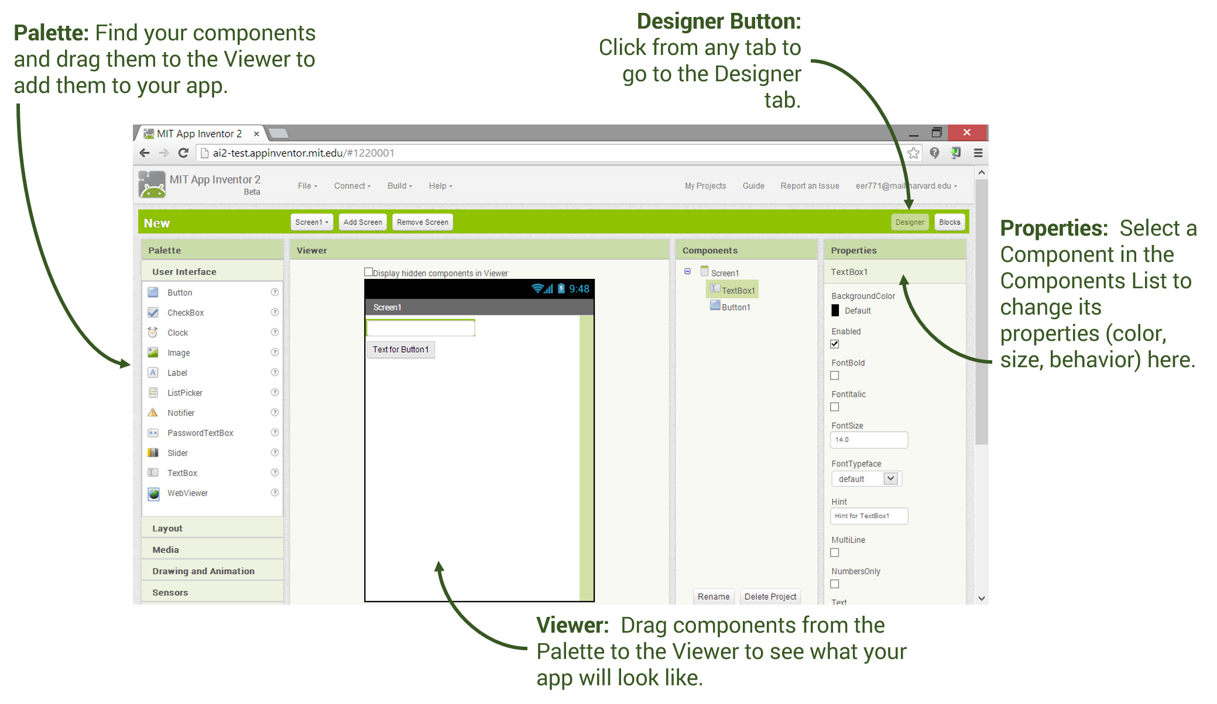
COMPONENTS OF APP INVENTOR WINDOW
1. THE COMPONENT DESIGNER

Slide 8
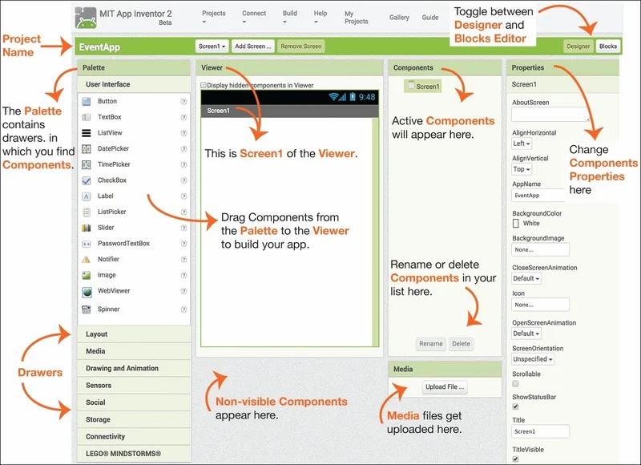
COMPONENTS OF APP INVENTOR WINDOW
1. THE COMPONENT DESIGNER

Slide 9
Fill in the blanks:
A …………. Is a shape that looks something like a puzzle.
....... ………..column allows you to manage the media files.
The ………. …….. Column shows a rectangular area that represents the app’s screen.
A ……. …….. …Is an item that performs a specific purpose within an app.
The ………………. …………shows a hierarchical structure of components.
blocks editor
media
viewer
component
component column

Slide 10
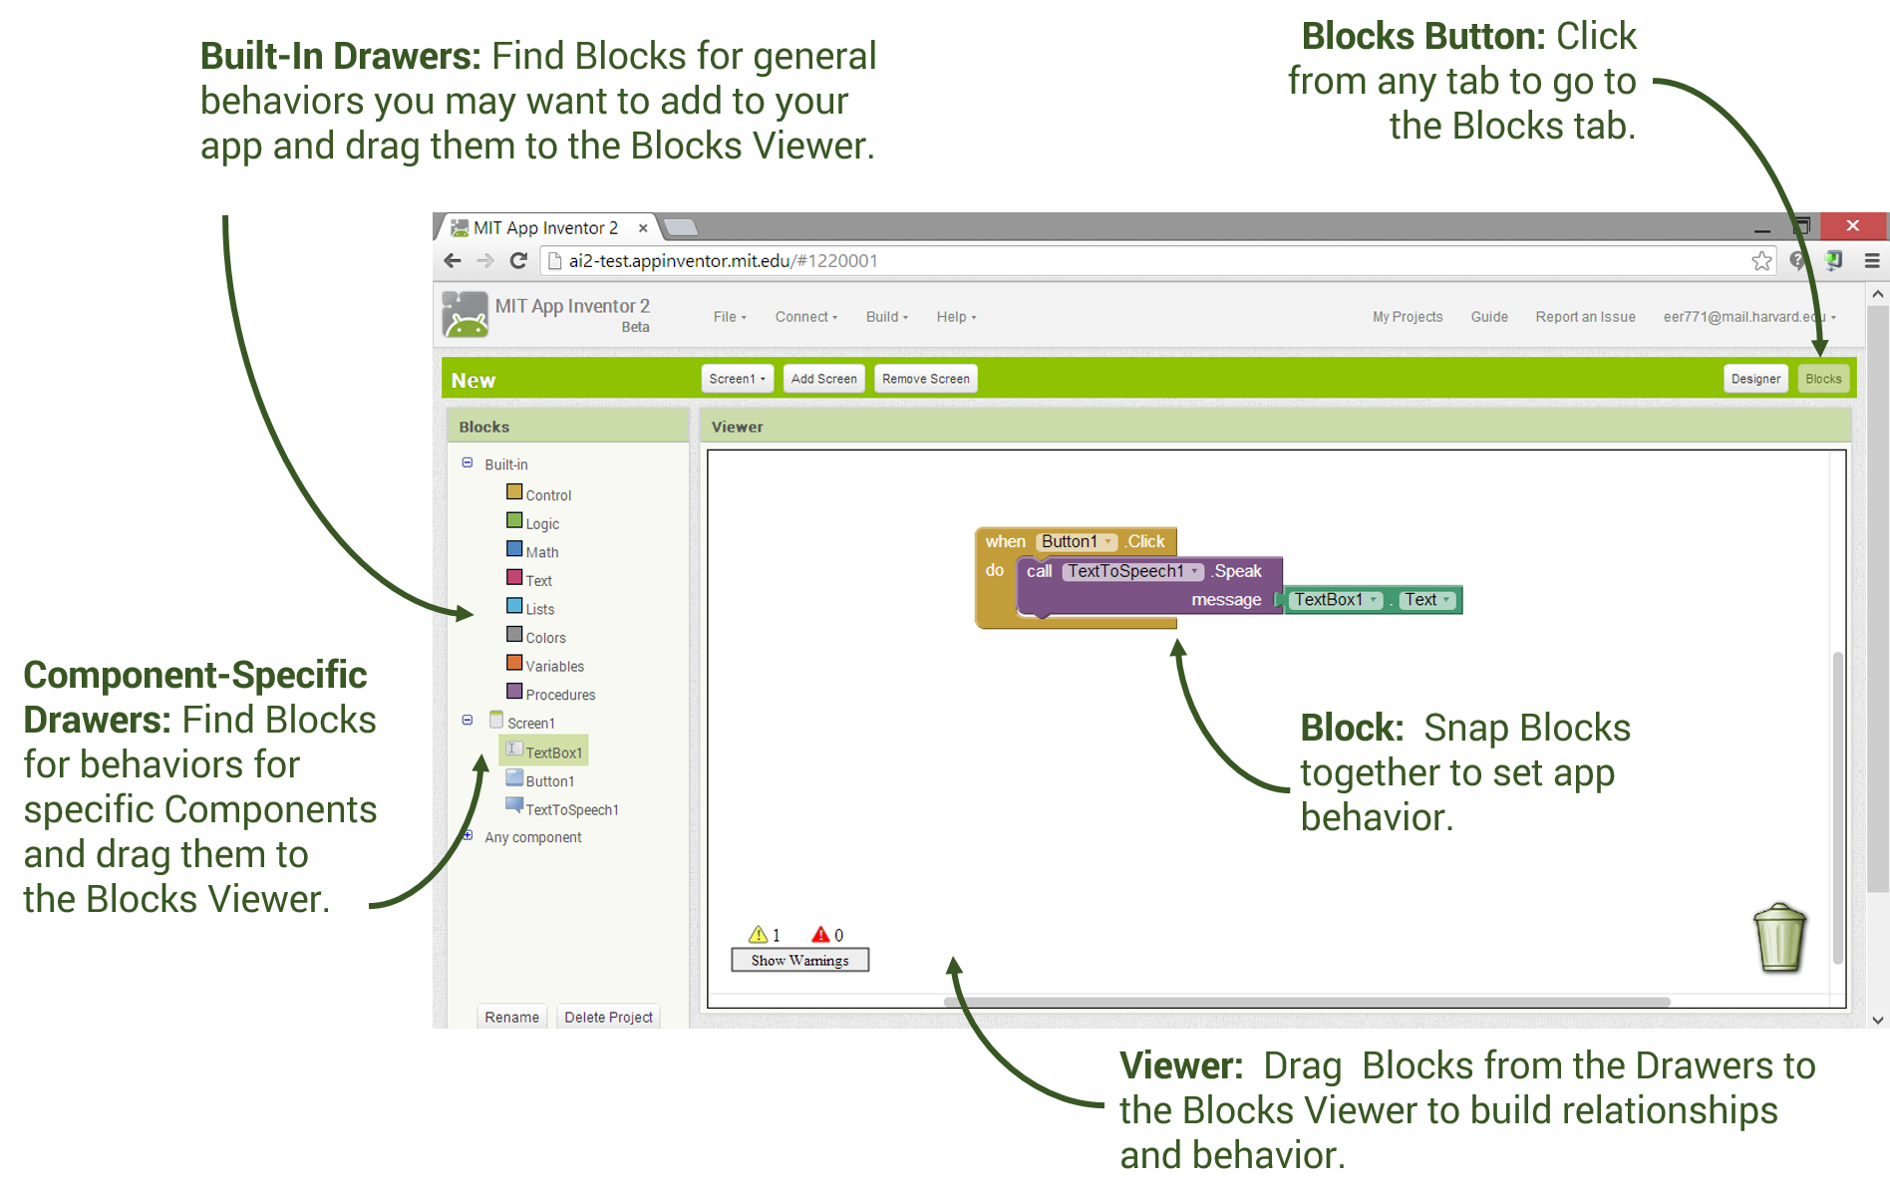
COMPONENTS OF APP INVENTOR WINDOW
2.THE BLOCKS EDITOR

Slide 11
Which of the following contains the deleted blocks?
Trash can
Recycle bin
Garbage bag
none

Slide 12
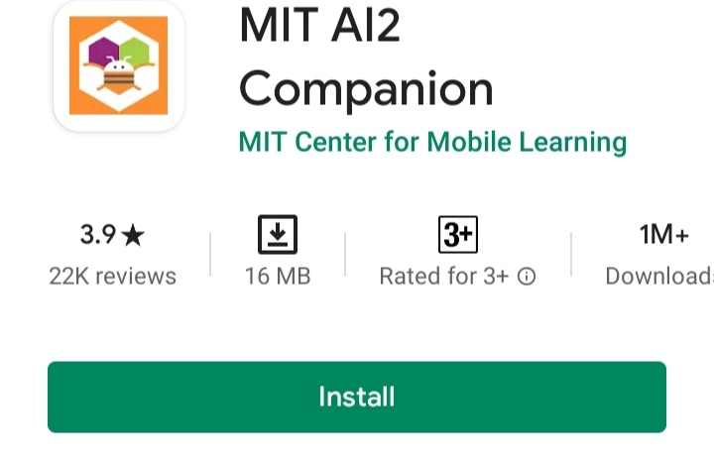
3. An android device
Steps to use MIT app inventor
Step 1: Open a Gmail account in case you don’t have one.
Step 2: Open the link and log in to your Gmail account.
Step 3: You need to install the App Inventor Companion App (MIT AI2 Companion) on our mobile device that helps in live testing of our application.
Step 4: We need to connect both mobile devices & laptops/desktop should be connected to the same WiFi network.

Slide 13
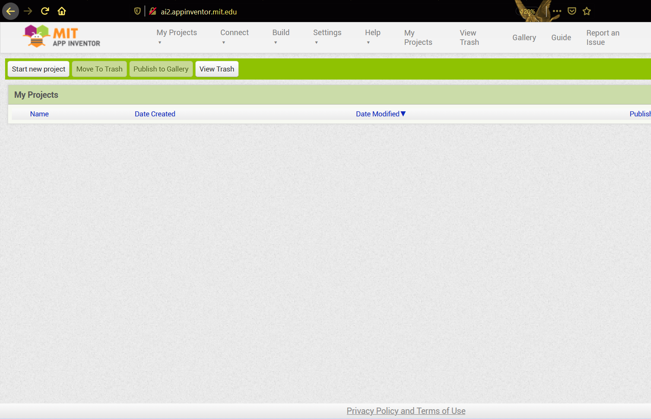
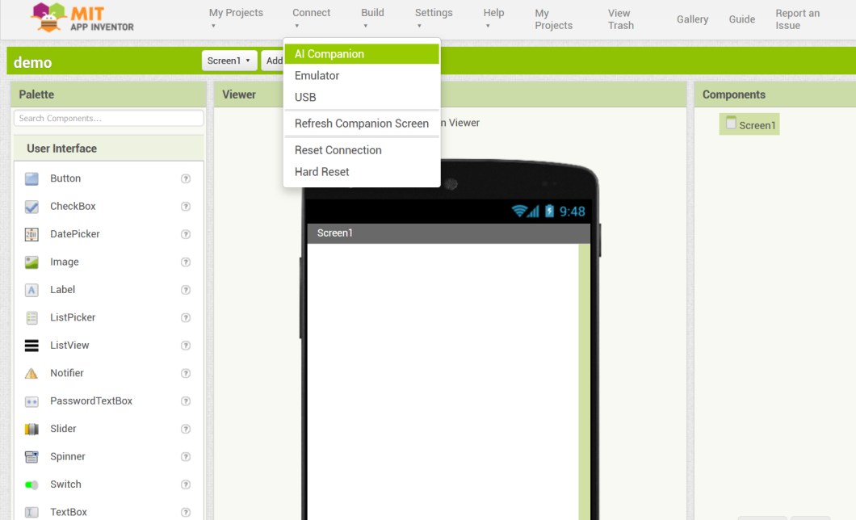
3. An android device
Steps to use MIT app inventor
Step 5: To start the app-building click on “Start New Project”.
Step 6: To connect your mobile device, choose “Connect” and “AI Companion” from the top menu.

Slide 14
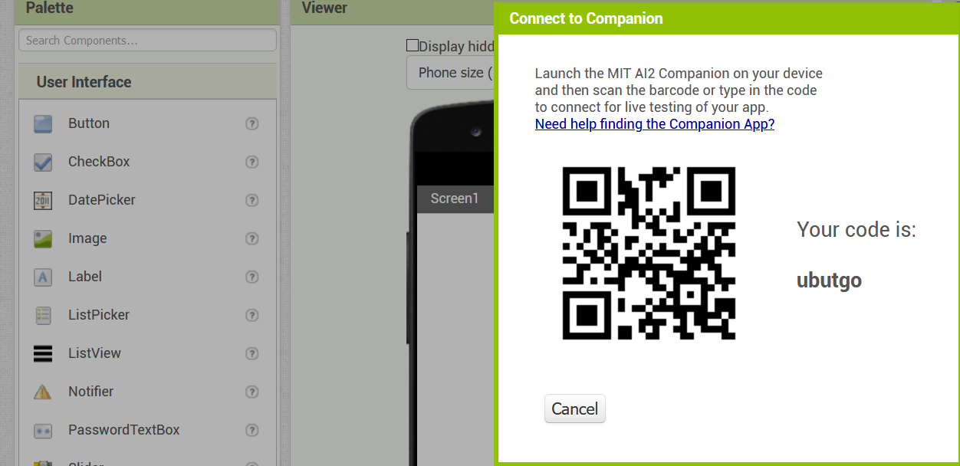
3. An android device
Steps to use MIT app inventor
Step 7: Now to connect the MIT AI2 App on your device and desktop/laptop scan the QR code or type the 6 digit code which is appearing on your PC screen.
Step 8: Now you can see the app you are building on your device.

Slide 15
What are the three key parts of the App inventor programming enviornment?
Android device
Viewer
Component designer
Blocks editor

Slide 16
Labels, buttons and text are all examples of ………………
Properties
Built-in-control
Components
blocks

Slide 17
Which of the following is used to test an app?
Emulator
Blocks editor
Component design
none

